Slide 1
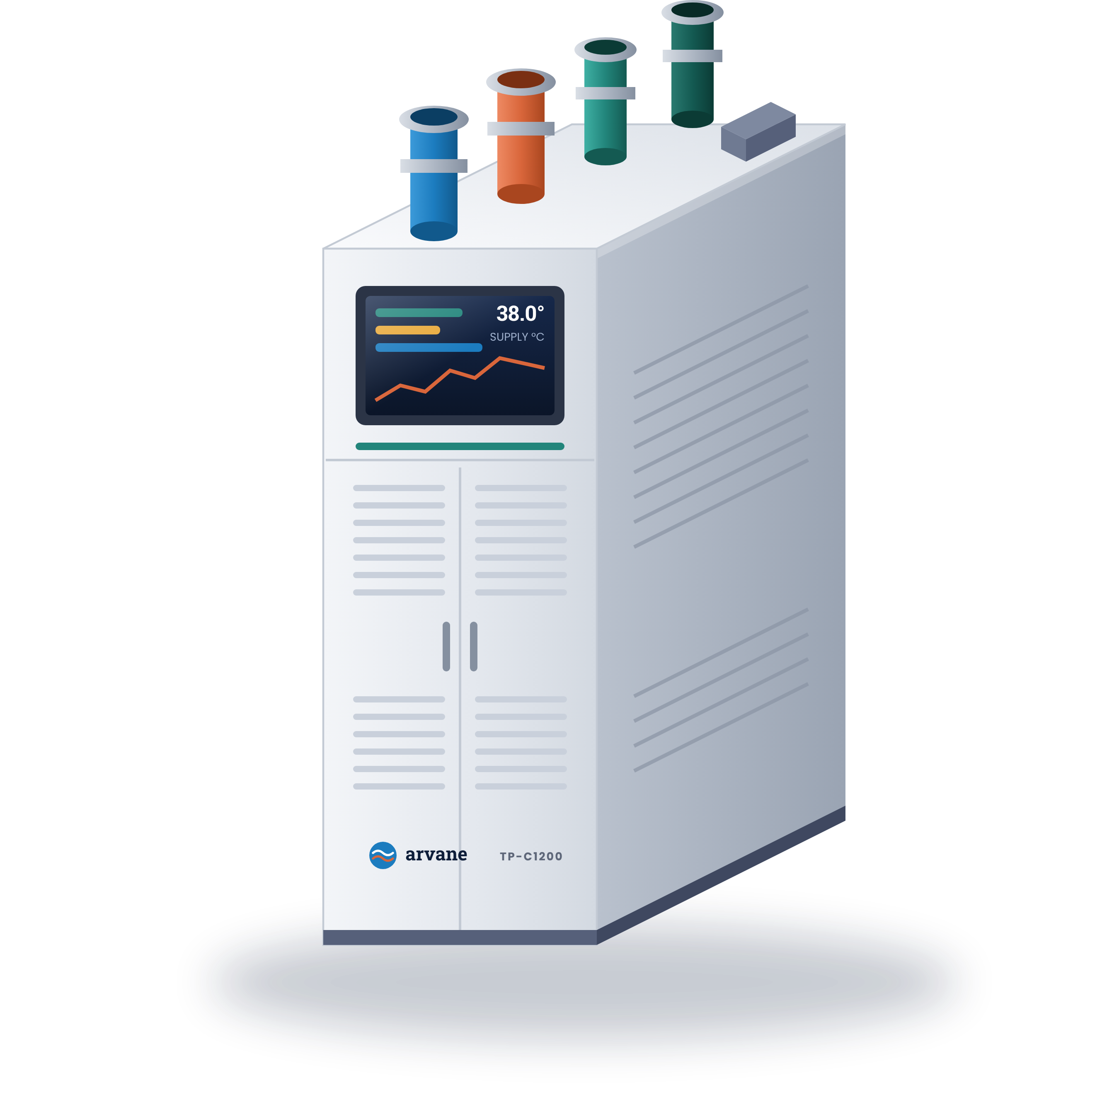
Corvia Cloud Hall C: Proposed Liquid Cooling System, Diagrams and Kitting
Direct-to-chip cooling for AI row 1 | For your design review | November 2026
TP-C1200 in-row CDU
Concept build. Arvane Thermal, Corvia Cloud and every product and spec are fictional.
Notes:
Open with the problem: Hall C was built for air, and the racks going into AI row 1 put out about three times what air can move. This deck walks the full proposal: what the system is, how it connects, how we prove it, and how it ships.

Slide 2
Air stops at about 40 kW a rack. Your new servers start at 120
Liquid takes the heat off the chips and hands it to the facility water you already run
120 kW
32 °C
N+1
1 rack
per rack, with room for three more racks on the CDU
facility water is all it needs. Dry coolers do most of the work
pumps in every CDU. A failed pump swaps out with the row running
is the most a leak can take offline. The rest keeps flowing
Liquid where the heat is
Two loops that never mix
Built to be serviced live
Cold plates take about 85% of the heat. A rear door catches the rest before it reaches the room.
Facility water stays on one side of the CDU. Filtered coolant runs to the servers on the other.
Dry-break couplings at every tray, valves at every rack, front-service pumps and filters.
Notes:
Land the four numbers, then the three ideas. If the room is mostly facilities people, spend the time on 32 °C water. If it is IT ops, spend it on dry-break couplings and one-rack leak isolation.

Slide 3
Proposed system at a glance
One CDU per row feeds every rack through overhead headers. These colors are used in every diagram
Role | Product | Part | Key point | Power
Cooling, row | In-row CDU | TP-C1200 | 1.2 MW. N+1 pumps. Loops never mix | 2x 400-480 VAC
Cooling, rack | In-rack CDU, 4U | TP-C120 | 120 kW. Pilot or single dense rack | 2x 208-415 VAC
Distribution | Rear rack manifold | TP-M48 | 24 supply, 24 return ports, sensing built in | None
Distribution | Dry-break coupling | TP-Q12 | No drip on release. One pair per tray | None
Distribution | Isolation valve set | TP-V | Shuts one rack off the header in seconds | 24 VDC
Air side | Rear-door heat exchanger | TP-RD50 | 50 kW. Takes the air heat plates miss | 208-240 VAC
Safety | Leak controller and rope | TP-LX / TP-LR | Finds a leak to 1 m, closes that rack | 100-240 VAC
Monitoring | Monitoring software | TP-View | Every point, into your BMS | Your VM
Notes:
This is the slide engineers screenshot. Walk it top to bottom: cooling, distribution, air side, safety, monitoring.

Slide 4

Coolant distribution units
Pick by how many racks it feeds: one row, or one rack
TP-C1200 in-row CDU
TP-C120 in-rack CDU
Sits at the end of the row like a rack. Moves heat from server coolant into facility water.
One rack on its own: the pilot, a lab, or a single dense rack in an air-cooled hall.
Capacity
1,200 kW at 6 K approach
Capacity
120 kW at 6 K approach
Flow
Up to 1,800 L/min
Flow
Up to 180 L/min
Supply temp
25 to 45 °C, ±0.5 K
Pumps
Redundant pair, hot-swap
Pumps
N+1, variable speed, hot-swap
Filtration
50 µm
Filtration
50 µm, live changeover
Power
2x 208-415 VAC
Power
2x 400-480 VAC, up to 15 kW
Size
4U, 1000 mm deep
Size
800 x 1200 x 2200 mm
Notes:
The CDU is the heart of the system. Most questions here are about facility water temps and what happens when a pump fails. Both answers are on the card.

Slide 5
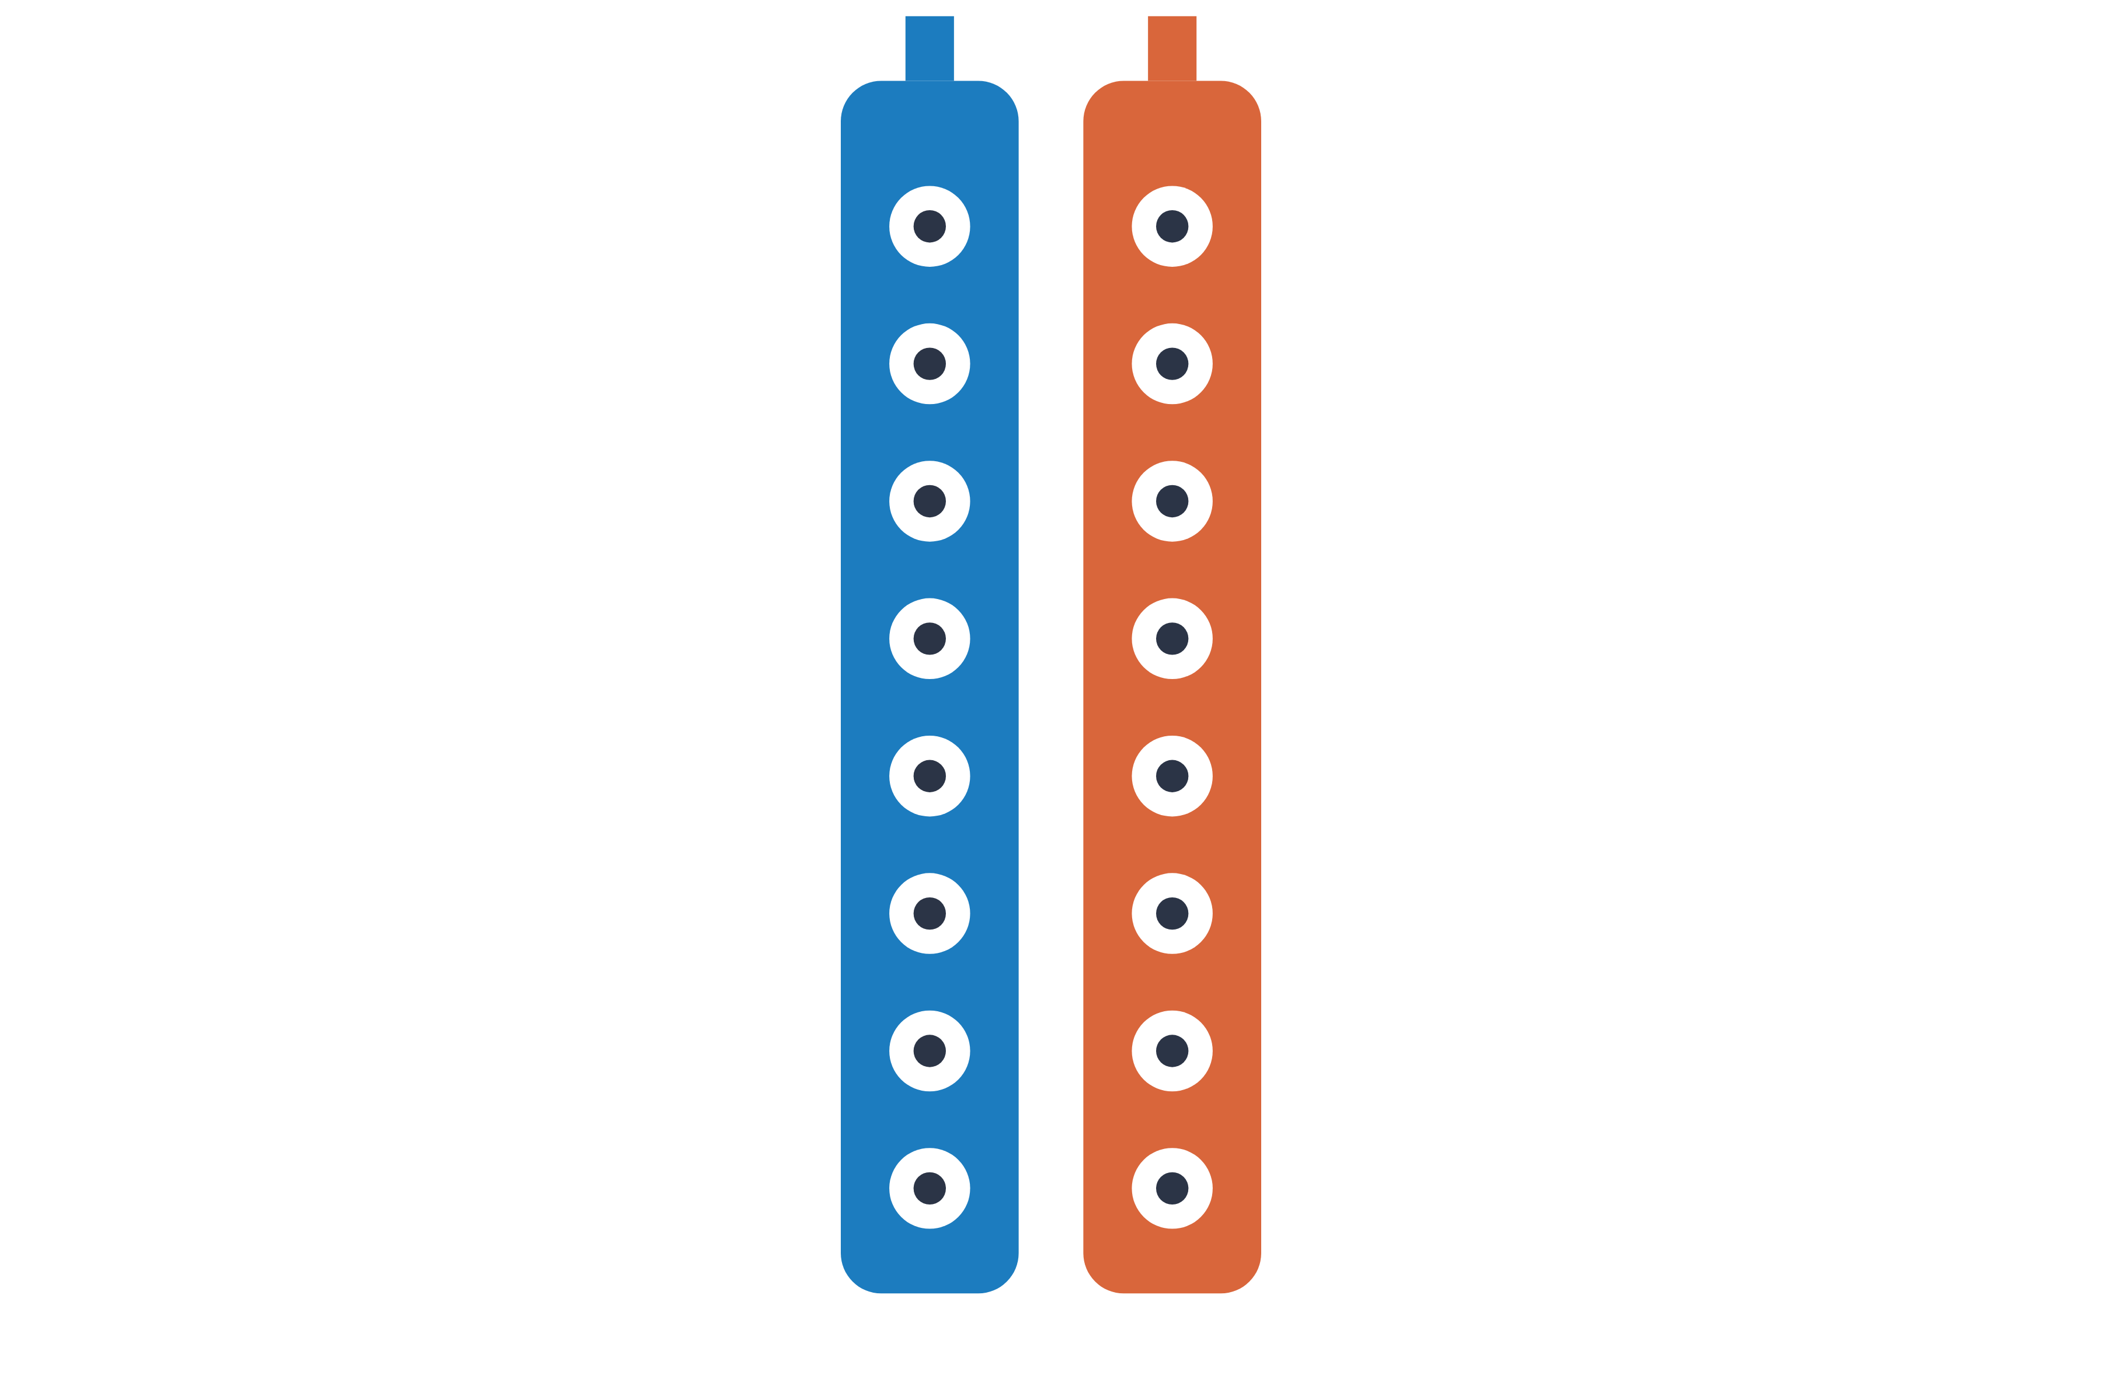
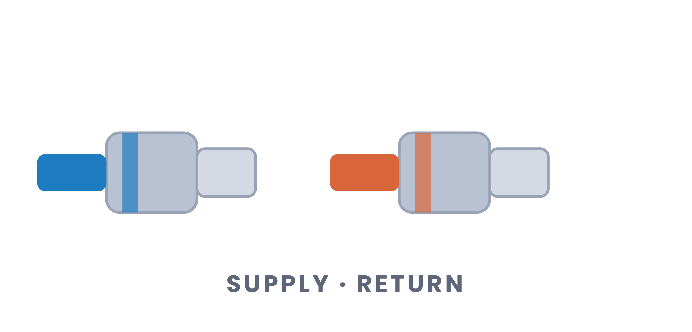
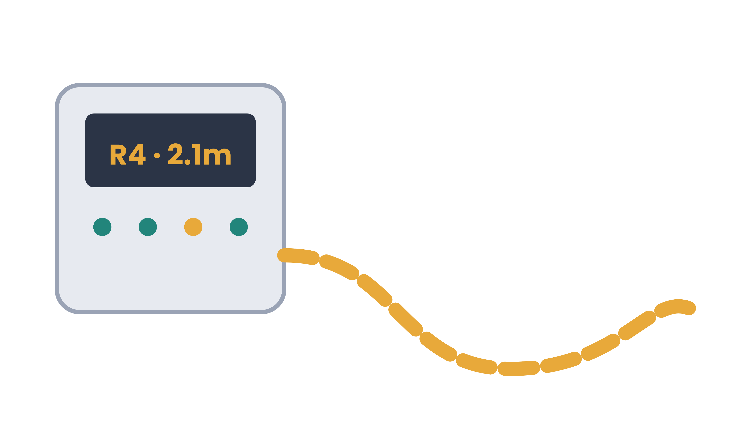
Distribution: manifold, couplings, valves
Everything between the header and the cold plate
TP-M48 rear rack manifold
TP-Q12 dry-break coupling
Valves and leak control
Ports
24 supply, 24 return
Flow
Up to 30 L/min
Locate
Leak to within 1 m
Inlet
1.5" with TP-V valves
Spill
Under 0.05 mL per release
Action
Closes that rack only
Sensing
Flow, inlet and outlet temp
Keyed
Blue and red cannot swap
Zones
4 ropes, 150 m each
Build
316 stainless, 10 bar
Seals
EPDM, glycol-rated
Alerts
Relay, BACnet, Modbus, SNMP
Notes:
IT ops cares most about this slide. The line to land: pull a server without draining anything.

Slide 6


Rear doors and monitoring
The air heat the cold plates miss, and one screen for every point
TP-RD50 rear-door heat exchanger
TP-View monitoring
Every CDU, manifold, door and leak point, with the same names in your BMS.
Hangs on the back of the rack. Takes the 15% of heat that still goes to air.
Capacity
Up to 50 kW
Points
Flow, pressure, temps, pumps, leaks
Fans
EC, speed set by exhaust temp
Out
BACnet/IP, Modbus, SNMPv3, REST
Water
From the CDU loop
Alerts
Email and webhook, by severity
Fit
42U and 48U, 600 or 800 mm
Runs on
Your VM, your network
Power
208-240 VAC, under 900 W
Cloud
Not required
Notes:
If the customer has existing CRAHs, the rear door is why they do not need more air handling. TP-View is the answer to every question about the NOC.

Slide 7
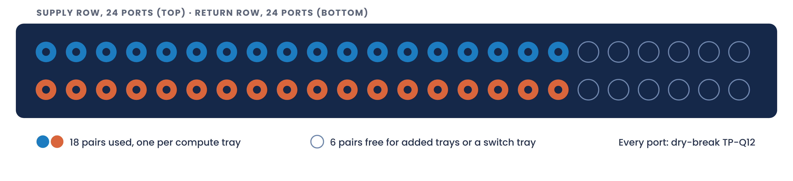
Manifold port plan
18 of 24 port pairs used per rack. Six spare pairs for added trays or a liquid-cooled switch
18
6
8-10
pairs used, one per compute tray
pairs free with no new manifold
L/min per tray at full load
Notes:
Point at the six free pairs. That is how we answer "what if the server spec changes": no new manifold.

Slide 8
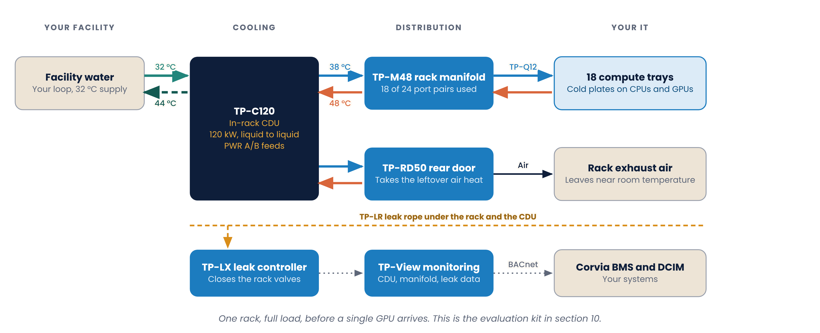
Design 1: Pilot rack
One rack with its own in-rack CDU. Proves cooling, leak response and the BMS link before the row goes in
Notes:
This is what ships for the evaluation, with a 120 kW load bank in place of servers.

Slide 9
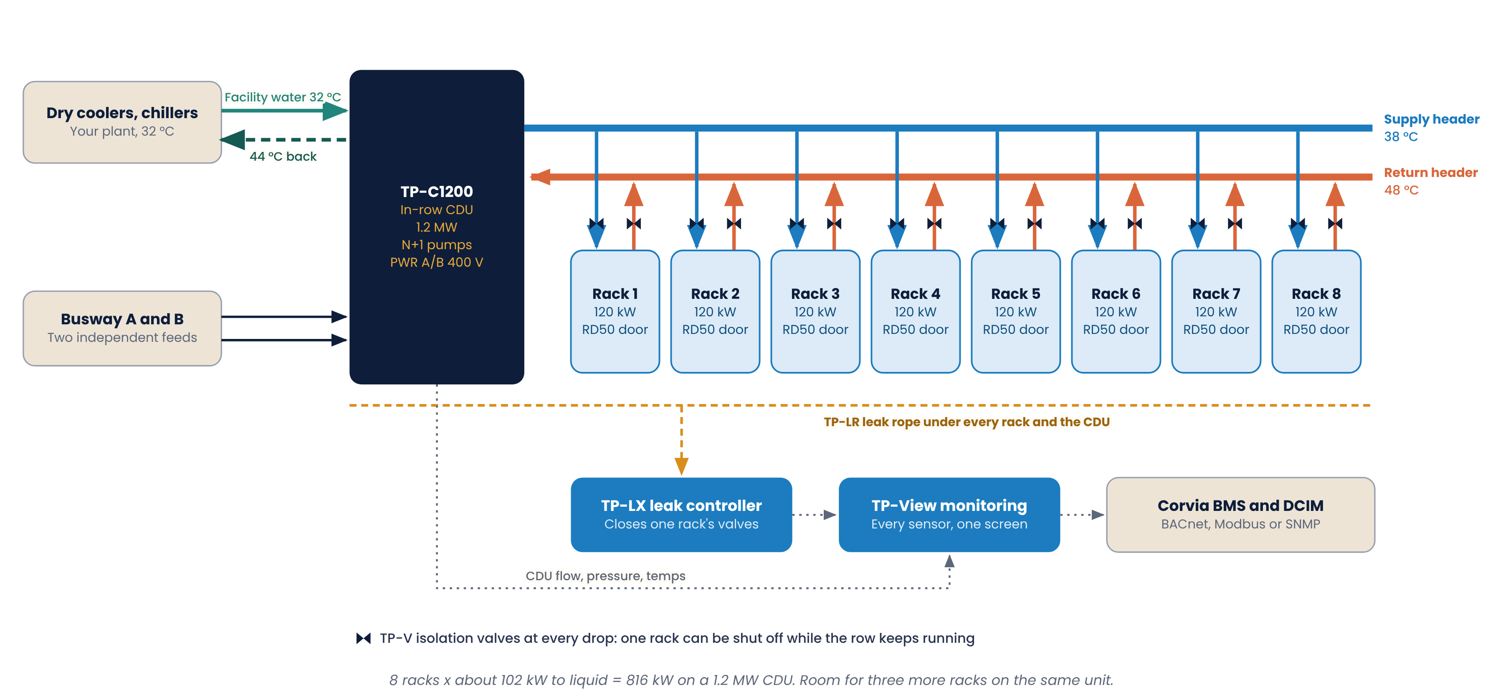
Design 2: One AI row, the Hall C proposal
One in-row CDU feeds eight 120 kW racks. Valves at every drop, rear door and leak coverage on every rack
Notes:
Walk left to right: plant, CDU, headers, racks. Then drop to the bottom row: leak and monitoring into their BMS.

Slide 10
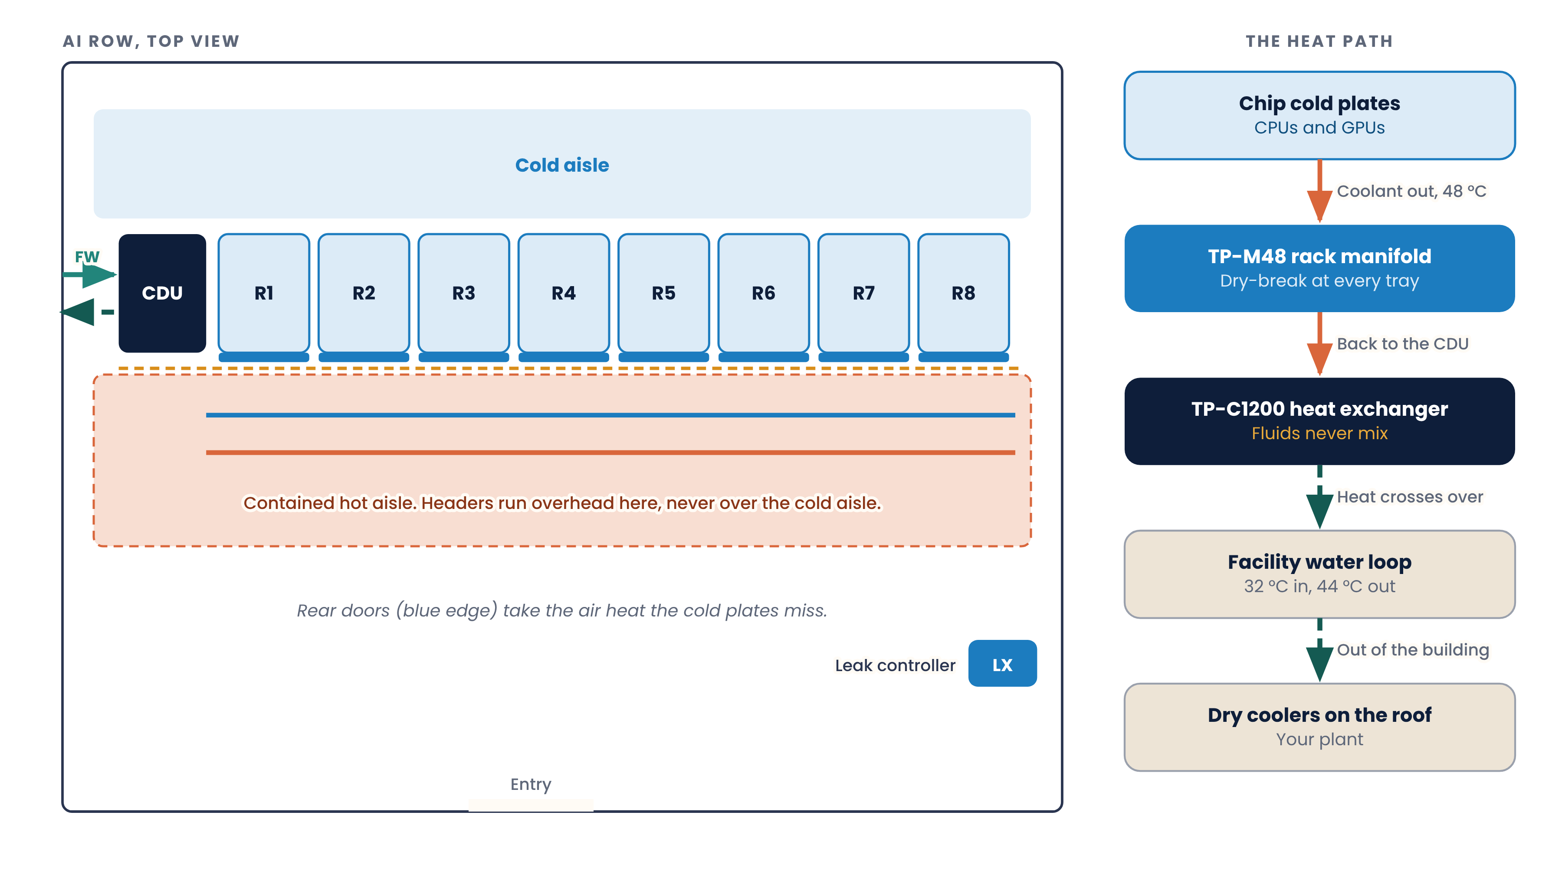
Row layout and the heat path
Headers run overhead in the contained hot aisle, never over the cold aisle
Notes:
Facilities will ask where the pipes go. Answer: hot aisle, overhead, with the rope underneath.

Slide 11
Where one row’s heat goes
Example load from typical AI servers. We redo this from your server specs before the quote
384 kW
headroom on the same CDU. About three more racks
85 / 15
split of each rack’s heat between liquid and air
8 x 120
racks and kW per rack, as drawn
Notes:
Chart is native, so it can be edited live in the meeting if they give us their real numbers.

Slide 12
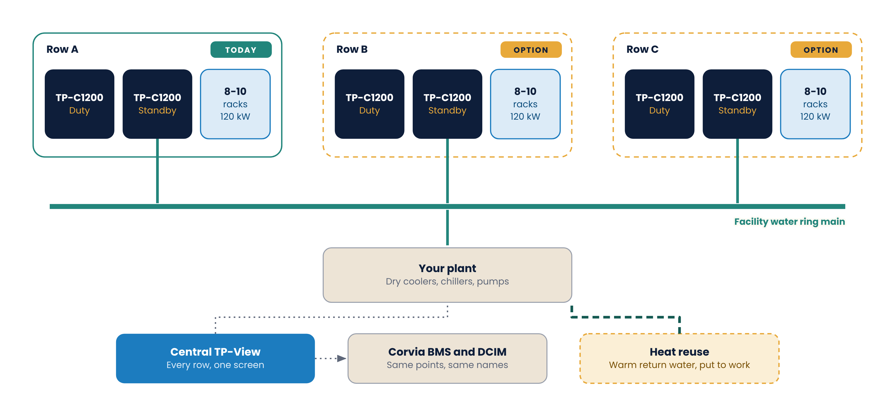
Design 3, option: the whole hall
Each row gets two CDUs for N+1. A facility water ring main joins them to your plant
Notes:
Only show this if they ask about growth. It proves the pilot and row-one spend is not wasted.

Slide 13
Two loops. Each has its own rules
Your facility water and our server coolant meet only inside the CDU
Facility water (FW): yours
Server coolant (TCS): ours
Runs
Your plant to each CDU
Runs
CDU to every cold plate
Temps
32 °C in, about 44 °C back
Temps
38 °C supply, 48 °C return
Flow
About 1,500 L/min per CDU
Flow
About 1.5 L/min per kW
Fluid
Your treatment, untouched
Fluid
PG25, filtered to 50 µm
Tap
DN100 grooved at the CDU
Build
316 stainless, EPDM hoses
Rules for every loop
Fluids never share a pipe. The plate heat exchanger is the only place they meet.
Blue is supply, red is return, everywhere. Couplings are keyed so they cannot swap.
Every header, drop and hose is pressure-tested at 1.5x working pressure, flushed and capped before it ships.
Notes:
Make the ownership line clear: their water, our coolant. That ends most scope arguments early.

Slide 14
Every pipe, hose and connection
Short hoses at the rack. Stainless headers everywhere else
Part | Where it goes | Guidance
FW mains | Your plant to the CDU | Your pipe and spec. DN100 grooved at the CDU
TCS headers | CDU to the row, overhead | 316 stainless, DN80. Pressure-tested before it ships
Rack drops | Header to TP-V valves | 1.5" braided hose, cut to your drawings
Tray hoses | Manifold port to server | EPDM, 1/2", TP-Q12 on both ends
Leak rope | Under every rack and the CDU | TP-LR on clips, away from joints you cannot reach
CDU power | Busway A and B | 2x 400-480 VAC, 3-phase, internal transfer
Monitoring | CDU, TP-LX, doors to TP-View | Your management VLAN. RJ45 or RS-485
Notes:
Hand this table to their mechanical contractor. It is the scope line.

Slide 15
Pilot rack for Corvia
Design 1 with a 120 kW liquid load bank in place of servers. Quantities are a starting point
Item | Part | Qty
In-rack CDU | TP-C120 | 1
Rear rack manifold | TP-M48 | 1
Isolation valve set | TP-V | 1
Dry-break couplings, pairs | TP-Q12 | 24
Rear-door heat exchanger | TP-RD50 | 1
Leak controller / ropes | TP-LX / TP-LR | 1 / 2
Liquid load bank, 120 kW | TP-LB120 | 1
Monitoring, pilot license | TP-View | 1
Coolant, PG25 | PG25 | 200 L
Fill and service cart | TP-FILL | 1
How it ships
Pressure-tested, flushed and capped
CDU set to your temps, on your network
Every part labeled to the drawing
Arvane engineer on site to fill and start
To decide with Corvia
Pilot length and terms. We suggest six weeks
Rack position and facility water tap
Who from your team runs the tests
Notes:
The load bank is the hook: they prove the cooling before a single GPU arrives, so the GPU delivery date is never blocked by cooling.

Slide 16
What a pass looks like
We draft this list. Corvia edits it. The pilot passes when their team checks every line
1
Holds 38 °C supply at 120 kW for 72 hours
2
Rack ΔT stays between 8 and 10 K
3
Pull one pump: the other carries full load
4
Release a TP-Q12 under flow: nothing on the pad
5
Wet the rope: alert in seconds, valves close
6
Every point in the BMS with the agreed names
7
Facility water stays inside agreed temps
8
Change a filter with the loop running
Notes:
Get them to edit this in the meeting. A pass list they wrote is a pass list they will sign.

Slide 17
Production kitting: one crate per rack
Arvane builds, pressure-tests and labels each rack kit, then ships it to your integrator ready to install
1. Order
2. Build
3. Test
4. Flush and cap
5. Label and pack
6. Ship
One kit per rack
Cut to your drawings
1.5x working pressure
Clean, dry, sealed
By row, rack, port
Serials and test reports
Kit numbers
In every crate
What your integrator gets
KIT-RACK-DLC: manifold, valves, hoses
KIT-RDHX: rear door with hoses
KIT-ROW-8: CDU, headers, 8 racks
KIT-LEAK and KIT-FILL
Parts for that rack position
Labels by row, rack and port
Packing list and rack drawing
Pressure test report with serials
One kit per rack type to stock
Serial list for DCIM records
No cutting or fitting on the floor
Optional spares kit per row
Notes:
Integrators love this slide. No cutting or fitting on the floor means faster installs and fewer leaks.

Slide 18
Open items before the quote
Corvia’s decisions on the left. What Arvane confirms on the right
For Corvia to decide
For Arvane to confirm
Facility water supply temp and the row 1 tap
Headers overhead or under the floor
Rack density target. 120 kW is drawn
Rear doors on every rack, or only where needed
N+1 inside one CDU, or two CDUs per row
Coolant: PG25 or treated water
BMS link: BACnet or Modbus
Heat load per rack from your server specs
Pipe sizes and pressure drop, end to end
CDU power against your busway
Lead time for each kit, in writing
Notes:
Close by assigning owners and dates to the left column. That is the real call to action.

Slide 19
From design review to a cool row
Nine weeks to a firm quote, with a pilot rack in the middle
1
2
3
4
5
6
WEEK 1
WEEK 2
WEEKS 3-8
WEEK 9
AFTER PO
GO LIVE
Design review
Site walk
Pilot rack
Final design and quote
Kits built and shipped
Fill, flush, load test
Account lead
Applications engineer
Kitting and commissioning
Proposal and quote
sales@arvane.example
Design and pilot
design@arvane.example
Build, test, fill, start-up
kits@arvane.example
Notes:
Ask for the site walk date before you leave the room.

Slide 20
Cool every AI rack in Hall C. Keep the hall you have.
Arvane Thermal · arvane.example
Concept build for a portfolio. Company, customer, products and specs are fictional.
Notes:
Thank them, confirm the site walk date, and send the datasheet and manual the same day.

